Slide 1

Report from the ASO AC
https://aso.icann.org/

Slide 2
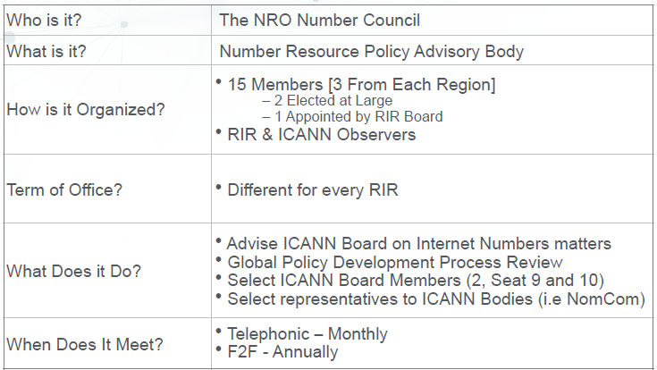
The ICANN ASO AC (Address Council)

Slide 3




2021 Address Council Members
REGION | Member | Term
 | Wafa Dahmani Zaafouri* Mike Silber [Vice Chair] Saul Stein | Jan 2021 – Dec 2021 Jan 2020 – Dec 2022 Jan 2021 – Dec 2023
 | Shubam Saran Nicole Chan* Aftab Siddiqui | Jan 2021 – Dec 2022 Jan 2021 – Dec 2021 Jan 2020 – Dec 2021
 | Kevin Blumberg* [Chair] Martin Hannigan Louie Lee | Jan 2021 – Dec 2023 Jan 2020 – Dec 2022 Jan 2019 – Dec 2021
 | Esteban Lescano* Ricardo Patara Jorge Villa | Apr 2021 – Mar 2022 Jan 2019 – Dec 2021 Jan 2021 – Dec 2023
 | Hervé Clément* [Vice Chair] Nurani Nimpuno James Kennedy | Jan 2021 – Dec 2023 Jan 2019 – Dec 2021 Jun 2021 – Dec 2022
Last appointments
Dr Di Ma (APNIC)
Jan 2022 – Dec 2023
Chris Quesada (ARIN)
Jan 2022 – Dec 2024
Remark: The community appointed ASO AC members in the RIPE region also serve on the IANA RC
(Nurani Nimpuno and James Kennedy)

Slide 4
2021 ASO AC Participation Record
REGION | Member | Attendance (11 regular meetings + 3 special)
 | Wafa Dahmani Zaafouri* Mike Silber [Vice Chair] Saul Stein | 8 (out of 11) 10 12
 | Shubam Saran Nicole Chan* Aftab Siddiqui | 12 14 10
 | Kevin Blumberg* [Chair] Martin Hannigan Louie Lee | 14 13 12
 | Esteban Lescano* Ricardo Patara Jorge Villa | 13 14 14
 | Hervé Clément* Nurani Nimpuno Filiz Yilmaz / James Kennedy | 14 13 7 (out of 8) / 6 (out of 6)

Slide 5
Global Policy Development
ASO AC members follow their respective RIR’s policy forum for any proposed global policy
There has been no global policy in the last years
A dedicated ASO AC meeting occurred last October
2021 Policy Proposal Facilitator Team (PPFT)
  Wafa Dahmani (AfriNIC)
  Shubham Saran (APNIC)
  Martin Hannigan (ARIN)
  Esteban Lescano (LACNIC)
  Hervé Clément (RIPE NCC)

Slide 6
ASO AC Transparency
Annual Face to Face meeting
  OPEN to observers (except for discussion related to ICANN Board Elections)
  Since 2020 the work has been taken place online – next 2022 ICANN meeting will be virtual
AC-DISCUSS mailing archive has OPEN public records
  https://aso.icann.org/pipermail/ac-discuss/
ASO AC Monthly Teleconference are OPEN to observers
  Normally first Wednesday of the month a 12:00 PM UTC
  2021 Meeting Calendar
  https://aso.icann.org/aso-ac/meetings/aso-ac-meeting-schedule/

Slide 7
ASO AC Appointments
ASO AC Current Appointments
Maemura Akinori
  Seat 10 ICANN Board, 2019 - 2022 (from APNIC Region)
Alan Barrett
  Seat 9 ICANN Board, 2021 - 2024 (from AfriNIC Region)
Brajesh Jain
  ASO Representative in the ICANN NomCom – 2022 term (from APNIC Region)
ASO AC 2022 Appointments
Seat 10 ICANN Board selection is ongoing (cf. next slide)
  Term 2022 – 2025 (AfriNIC region not eligible)

Slide 8
Seat 10 ICANN Board selection Timeline
– Nomination Phase: 15 September 2021 – 1st December 2021
– Comments Phase: 30 December 2021 – 30 March 2022
ICANN Due Diligence for nominated candidates
– Interview Phase: 29 January 2022 –30 March 2022
– Selection Phase (deliberation): 1st April – 16 April 2022
– Selection Phase (voting): 19 – 25 April 2022
– Announcement of selected candidate: around 30 April 2022

