Slide 1
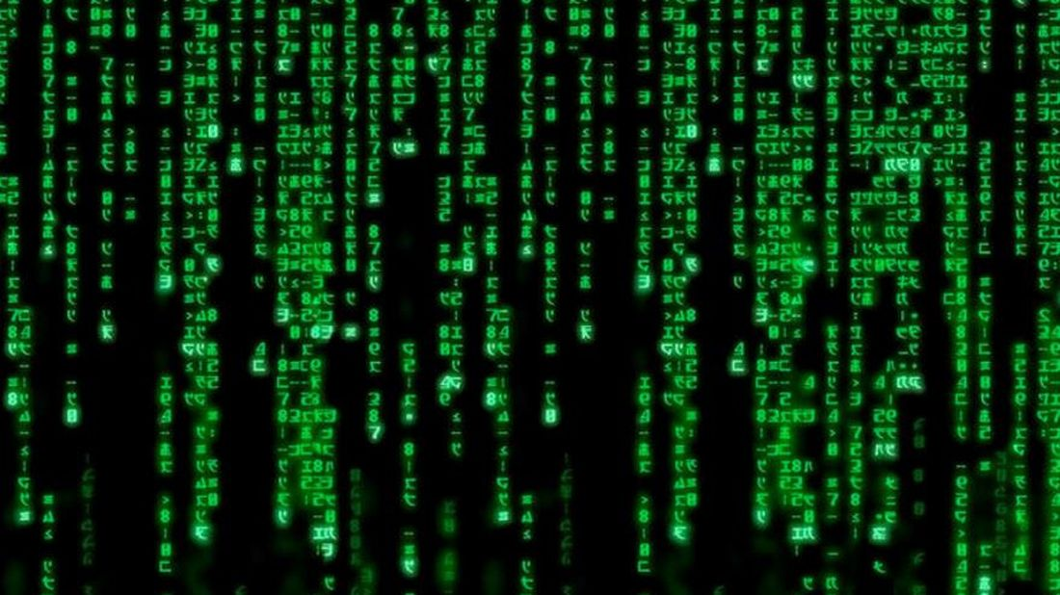
Troubleshooting with QUIC
In search of lost metrics
Alexandre Ferrieux, Isabelle Hamchaoui
Orange Innovation

Slide 2
What is QUIC ?
Child of the NSA scandal : Enhanced privacy, no linkability!
A transport protocol similar to advanced TCP versions with deep encryption to avoid ossification
30%of Orange traffic
Start in 2014, IETF standard in 2021
HTTP/3
Standard Transport Layer
QUIC

Slide 3
Layer 4 in theory
The transport layer
End-to-end connectivity
TCP, UDP
Error control (TCP)
Flow control (TCP)
Data
Layer 5+ HTTP
#6
#8
#9
HTTP
Layer 4 TCP
TCP
Layer 3 IP
IP
IP
Ack
#4
#2

Slide 4
Reality check
TCP transport layer
Middleboxes interfere “illegitimately” in the Transport Layer Proxy, optimizer, etc.
Middleboxes far behind standards
→ New Transport protocols blocked
→ New TCP mechanisms blocked : e.g. TCP fast open
→ Ossification of the Internet, innovation blocked for decades
Data
Layer 5+ HTTP
#6
#8
#9
HTTP
Layer 4 TCP
TCP
TCP
Layer 3 IP
IP
IP
Ack
#4
#2

Slide 5
QUIC is an answer…
TCP-like transport built over UDP + encryption
Ossification-ender
Middleboxes interference made difficult by QUIC headers encryption
HTTP/2
Data
HTTP/2
#6
#8
#9
TLS
TLS
TCP
TCP
IP
IP
Ack
#4
#2

Slide 6
QUIC is an answer…
TCP-like transport built over UDP + encryption
Ossification-ender
Middleboxes interference made difficult by QUIC headers encryption
HTTP/2
HTTP/3
Data
HTTP/2
HTTP/3
#6
#8
#9
TLS
QUIC
TLS
QUIC
TCP
TCP
UDP
UDP
IP
IP
IP
IP
Ack
#4
#2

Slide 7
QUIC is an answer…
TCP-like transport built over UDP + encryption
Ossification-ender
Middleboxes interference made difficult by QUIC headers encryption
HTTP/2
HTTP/3
Data
HTTP/2
HTTP/3
#6
#8
#9
TLS
QUIC
TLS
QUIC
TCP
TCP
UDP
UDP
IP
IP
IP
IP
Ack
#4
#2

Slide 8
TCP one point passive measurement
⁶8⁹
Data
#6
#8
#8
#9
Losses
⁴2¹
Ack
#4
#8
#2
Upstream and downstream loss (+ delay) Location of the faulty segment / actor
TCP

Slide 9
With QUIC, we’re not in Kansas anymore….
?
QUIC

Slide 10
What else then? Packet drop counters?
IP loss counters
?
?
QUIC
Poor and cumbersome diagnosis
Counters not available in all nodes => no exhaustivity
No upstream/downstream loss: where is the faulty segment / actor?

Slide 11
2-points measurements?
Access Provider lead
?
?
?
No end-to-end degradation detection
AP needs simultaneous captures from various (trusted?) actors
Capture in customer OS?
QUIC
Content Provider lead
?
?
?
?
?
End-to-end degradation detection
CP needs simultaneous captures from various (trusted?) actors
Should we perform captures on behalf of Google? Facebook? Bullshit.com?
QUIC

Slide 12
Active measurement
?
?
?
Representativity (UE/server configuration, multipath)
→ For specific investigations only
QUIC

Slide 13
Key disclosure
The dream solution!
Key disclosure by client or server
Awesome! Back to TCP debug
Any chance to get it?
QUIC

Slide 14
The Loss bits mechanism
What?
Detect and locate faulty segments without packet number
How?
Reference patterns drawn in the packet flows with 2 bits in clear in the QUIC header

Slide 15
The loss bits proposal (1)
Upstream Loss
N packets
Upstream Loss exposed via 1 bit in clear
Our proposal

Slide 16
The loss bits proposal (2)
Upstream Loss
End-to-end Loss
End-to-end Loss exposed via 1 bit in clear
Our proposal

Slide 17
The Loss Bits in the wild
Field Trial with Akamai in 4 Orange affiliates
Akamai CDN servers with loss bits implementation
Thousands of Orange real clients
Loss bits mechanism refined and validated
Additional validation by Satcom on Akamai servers and a satellite link
Acces network
Core network
Internet

Slide 18
Wrap-up
Current Troubleshooting practices are threatened
In case of bad customer experience with QUIC, no easy way to locate faulty segment and prove actors’ responsibility
New balance of power within the IETF arena
Strong support from Akamai and CDN providers
Very few operators expressed interest : Satcom, Telecom Italia
Lukewarm support from Google, Microsoft, Apple
Fierce opposition from Facebook and Mozilla
Wait… Is loss still critical?
BBR is quite robust to mild loss
Other Loss sensitive services ?
Our mechanism is ultra light, energy efficienty, and still useful for strong loss

Slide 19
References
First draft presented at IETF 104 (March 2019) https://datatracker.ietf.org/doc/draft-ferrieuxhamchaoui-quic-lossbits
Orange-Akamai trial presented at IETF 105 (July 2019) https://datatracker.ietf.org/meeting/105/materials/slides-105-maprg-packet-loss-signaling-for-encrypted-protocols-01
Akamai+lightspeed step-in at IETF 106 (November 2019) https://datatracker.ietf.org/doc/draft-ferrieuxhamchaoui-tsvwg-lossbits/
Satcom trial presented at IETF 106 (November 2019) https://datatracker.ietf.org/meeting/106/materials/slides-106-maprg-losses-in-satcom-systems-identification-and-impact
Joint draft with Telecom Italia (mars 2020) https://datatracker.ietf.org/doc/draft-mdt-ippm-explicit-flow-measurements/
Independent evaluation from Ike Kunze et al. (Aachen university)
L, Q, R, and T: which spin bit cousin is here to stay? (ANRW '21)

Slide 20
Thank you

